Slide 1
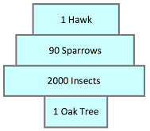
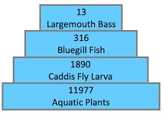
Daily Review
Types of Ecological Pyramids
Pyramid of numbers shows how many organisms are at each trophic level
There are two types of pyramid of numbers: upright and inverted.
Explain the difference between an upright pyramid of numbers and an inverted pyramid of numbers.

Slide 2
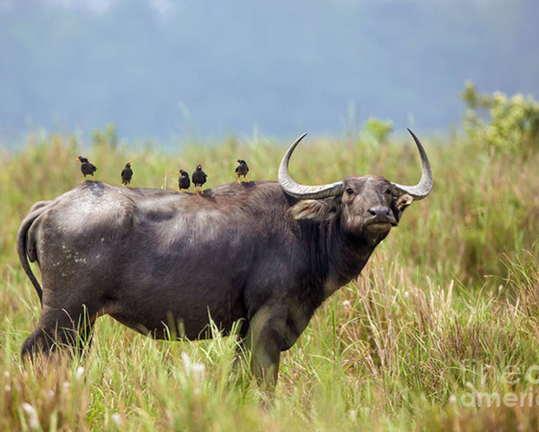
Daily Review
Relationships Between Organisms
Describing Relationships
Use the flow chart to identify the relationship Use the words in the flow chart to describe the relationship
Same Species
Different Species
Helping the species survive
Fighting for resources
Short term
Long term
Working together
Producing offspring
One hunting another
Both benefit
One benefits
One is harmed
Small birds follow buffalo as they graze. The buffalo stir up insects that are eaten by the birds.
Collaboration
Competition
Mutualism
Parasitic
Mating
Predator-Prey
Commensalism
This relationship is commensalism. It is a long term relationship between different species where one species benefits and the other is unaffected.

Slide 3
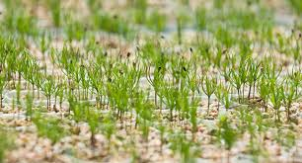
Daily Review
Relationships Between Organisms
Describing Relationships
Use the flow chart to identify the relationship Use the words in the flow chart to describe the relationship
Same Species
Different Species
Helping the species survive
Fighting for resources
Short term
Long term
Working together
Producing offspring
One hunting another
Both benefit
One benefits
One is harmed
Seeds from the same parent plant are growing close together in the same patch of soil.
Collaboration
Competition
Mutualism
Parasitic
Mating
Predator-Prey
Commensalism
This relationship is competition. It is a short term relationship within the same species where they are fighting for the same resources.

Slide 4
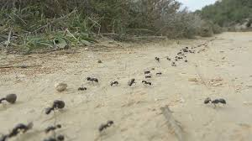
Daily Review
Populations and Communities
A population is a group of the same species living in the same place at the same time.
A community is different populations living in the same place at the same time.
How is a population different to a community?
Give an example of a population and a community in a jungle ecosystem.

Slide 5
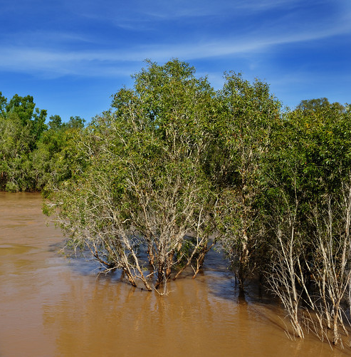
Daily Review
Disruptions to Ecosystems
Ecosystems can be disrupted by natural processes or human activity.
Name two natural disruptions to ecosystems and two disruptions caused by humans.
Floods can benefit ecosystems, but also cause harm.
Explain one way a flood benefits an ecosystem.
Explain one way a flood can harm an ecosystem.

Slide 6
Stability in Ecosystems

Slide 7
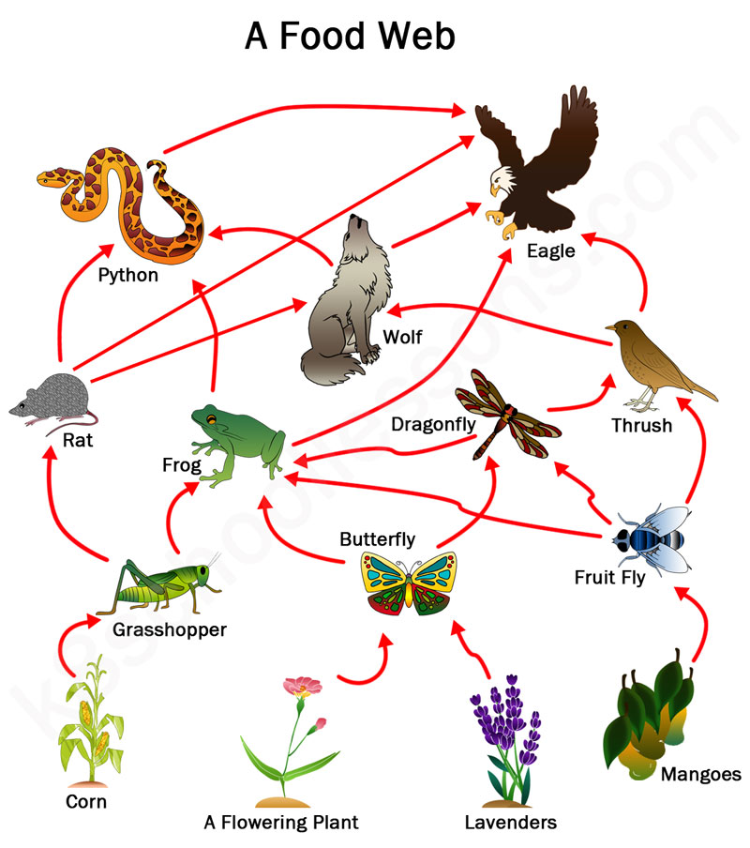
Learning Objectives
CFU
What are we going to learn?
Define a dynamic equilibrium in a population or community
Interpret simple population graphs
Activate Prior Knowledge
The picture shows a food web.
A drought causes a decline in the mango population.
Describe one direct impact and one indirect impact on the food web.

Slide 8
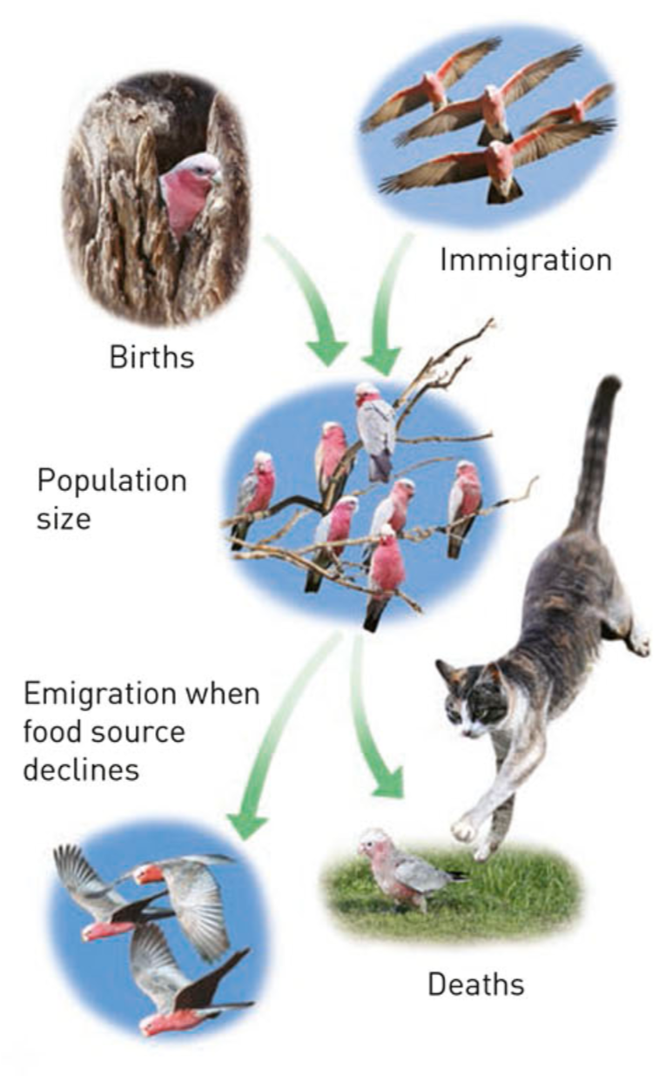
Concept Development
CFU 1
Why do ecosystems need to be balanced?
CFU 2
Which two processes cause populations to increase?
Stability in Ecosystems
All organisms live in a complex web of relationships, with each other and their environment.
An ecosystem needs to maintain a balance so that all species can exist at an ideal population size.
Population gains due to reproduction and immigration must balance the loss due to death and emigration.
This type of balance is called a dynamic equilibrium
CFU 3
How is immigration different to emigration?
CFU 4
What is a dynamic equilibrium?
Vocabulary
em·i·gra·tion (noun) leaving to go to a new area im·mi·gra·tion (noun) coming into a new area dy·na·mic (adjective) constantly changing e·qui·li·bri·um (noun) a state of balance

Slide 9
Concept Development
CFU 1
What happens when a change disrupts an ecosystem?
Dynamic Equilibrium
Changes can upset the equilibrium (or balance) in an ecosystem.
A new equilibrium will become established that responds to the change.
The new equilibrium is often very similar to the original.
CFU 2
Think, pair, share: How is competition different to collaboration and mating?
Vocabulary
em·i·gra·tion (noun) leaving to go to a new area im·mi·gra·tion (noun) coming into a new area dy·na·mic (adjective) constantly changing e·qui·li·bri·um (noun) a state of balance

Slide 10
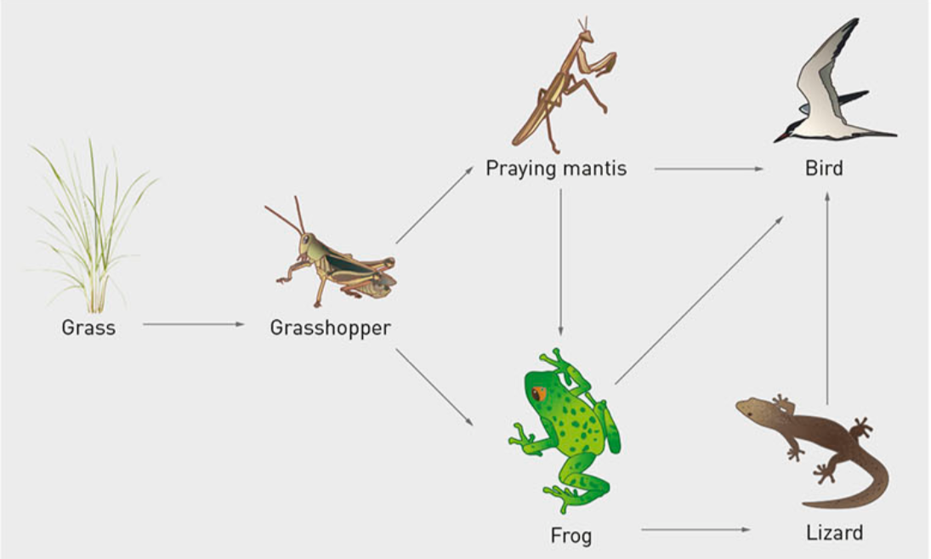
Concept Development
CFU 1
Pair, share: What would happen to the number of praying mantis?
Dynamic Equilibrium
If the number of frogs decreased, changes could include:
Increase in grasshoppers and a depletion of grass
Increase in praying mantis because of more grasshoppers
Decrease in lizard numbers because there are fewer frogs
Birds will feed on praying mantis rather than frogs and lizards
The praying mantis numbers will start to decrease
Grasshopper numbers will increase further and cause more grass to be depleted
CFU 2
Pair, share: What would happen to the number of lizards?
CFU 3
Pair, share: What impact will this have on praying mantis numbers?

Slide 11
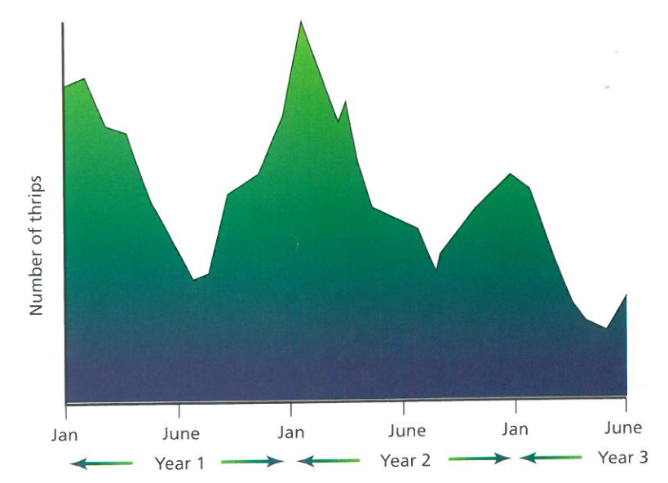
Concept Development
CFU 1
What does a population graph show?
CFU 2
Pair, share: What are the two types of relationships population graphs can show?
Population Graphs
Population graphs show how a population changes over time.
They can show the relationship between an individual population and changes to their environment.
They can also show the relationship between two or more populations.
CFU 3
Pair, share: Which type of graph is this? Explain your choice.

Slide 12
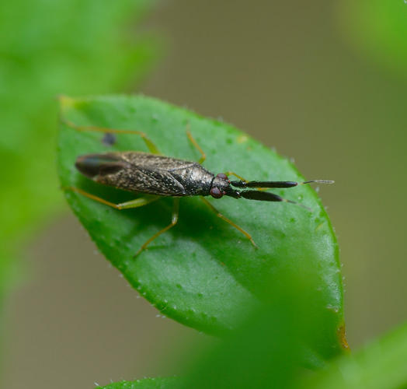
Skill Development/Guided Practice
Interpreting Population Graphs
Describe the general shape of the graph Make an inference about what causes the change in shape of the graph
Example 1: Thrips are small insects that feed on the flowers of certain plants.
1. Describe the shape of the graph
The thrip population is at its highest in January and lowest in June.
2. Make an inference
There are more flowers for the thrip to feed on in January, so their population increases.
Extension Question
Pair, share: The population peak is lowest in Year 3. Why might have caused this?
Vocabulary
in·fer·ence (noun) a likely explanation of an observation

Slide 13
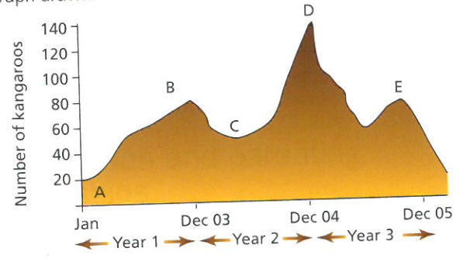
Skill Development/Guided Practice
Interpreting Population Graphs
Describe the general shape of the graph Make an inference about what causes the change in shape of the graph
Example 2: The population of kangaroos on a golf course was monitored over 3 years.
1. Describe the shape of the graph
The kangaroo population peaks in December/Summer and drops in Winter.
2. Make an inference
There is more grass for the kangaroos to feed on in Summer, so their population increases.
Extension Question
Pair, share: Why might there have been an extra large number of kangaroos in December of Year 2?
Vocabulary
in·fer·ence (noun) a likely explanation of an observation

Slide 14
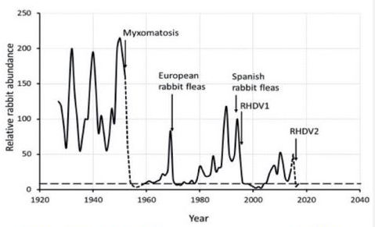
Skill Development/Guided Practice
Interpreting Population Graphs
Describe the general shape of the graph Make an inference about what causes the change in shape of the graph
Example 3: The Myxomatosis virus was introduced into a population of rabbits in 1950.
Extension Question
Pair, share: European rabbit fleas were released in the 1970s to control the rabbit population. Why do you think they didn’t re-release Myxamatosis?
1. Describe the shape of that portion of the graph
After the virus is introduced, the population of rabbits dropped to close to zero.
2. Make an inference
The virus killed a large number of rabbits in the population.
Vocabulary
in·fer·ence (noun) a likely explanation of an observation

Slide 15
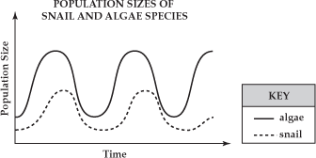
Skill Development/Guided Practice
Interpreting Population Graphs
Describe the general shape of the graph Make an inference about what causes the change in shape of the graph
Example 4: Snail and algae populations in a lake were monitored over a period of time.
Extension Question
Pair, share: Why does the snail population peak after the algae population?
1. Describe the shape of the graph
A short time after a peak in the algae population, there is a peak in the snail population.
2. Make an inference
The snails feed on the algae, so when there is more algae, there are more snails.
Vocabulary
in·fer·ence (noun) a likely explanation of an observation

Slide 16
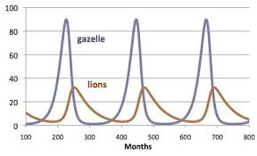
Skill Development/Guided Practice
Interpreting Population Graphs
Describe the general shape of the graph Make an inference about what causes the change in shape of the graph
Example 5: Gazelle and lion populations in a lake were monitored over a period of time.
1. Describe the shape of the graph
A short time after a peak in the gazelle population, there is a peak in the lion population.
2. Make an inference
The lions feed on the gazelles, so when there are more gazelles, there are more lions.
Vocabulary
in·fer·ence (noun) a likely explanation of an observation

Slide 17
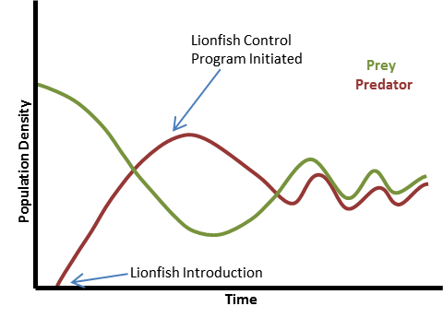
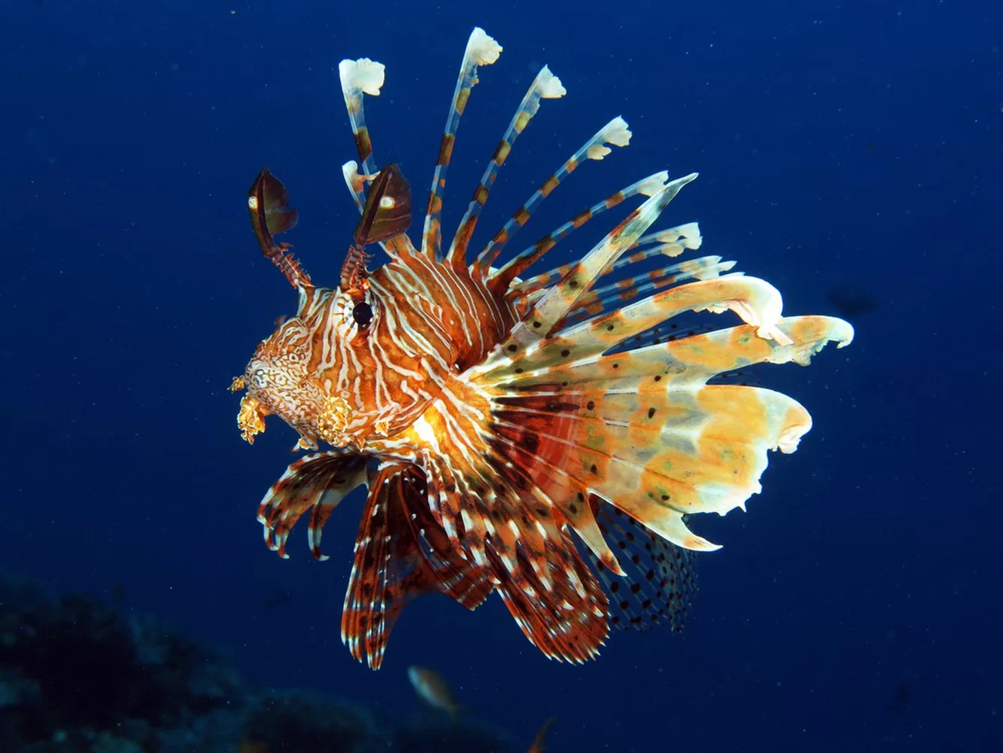
Skill Development/Guided Practice
Interpreting Population Graphs
Describe the general shape of the graph Make an inference about what causes the change in shape of the graph
Example 6: Lionfish are introduced into an ecosystem.
1. Describe the shape of that portion of the graph
2. Make an inference
Vocabulary
in·fer·ence (noun) a likely explanation of an observation
Notes:
Extension Slide – can be skipped for mainstream

Slide 18
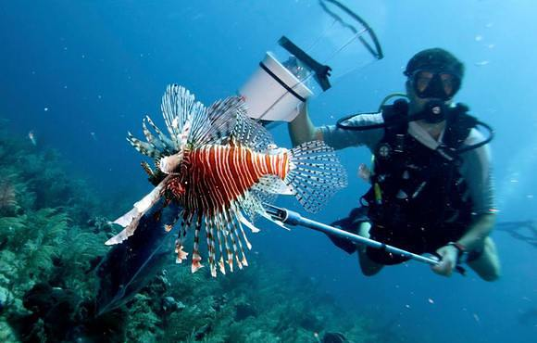
Skill Development/Guided Practice
Interpreting Population Graphs
Describe the general shape of the graph Make an inference about what causes the change in shape of the graph
Example 7: Controls are put in place to reduce the lionfish population (divers catch lionfish)
1. Describe the shape of that portion of the graph
2. Make an inference
Vocabulary
in·fer·ence (noun) a likely explanation of an observation
Notes:
Extension Slide – can be skipped for mainstream

Slide 19
Skill Development/Guided Practice
Interpreting Population Graphs
Describe the general shape of the graph Make an inference about what causes the change in shape of the graph
Example 8: The lionfish and their prey reach an equilibrium.
1. Describe the shape of that portion of the graph
2. Make an inference
Vocabulary
in·fer·ence (noun) a likely explanation of an observation
Notes:
Extension Slide – can be skipped for mainstream

Slide 20
Relevance
Ecosystems are complex interactions between organisms and their surroundings.
Being able to interpret simple population graphs will help you understand the balance that exists between organisms and their environment.

Slide 21
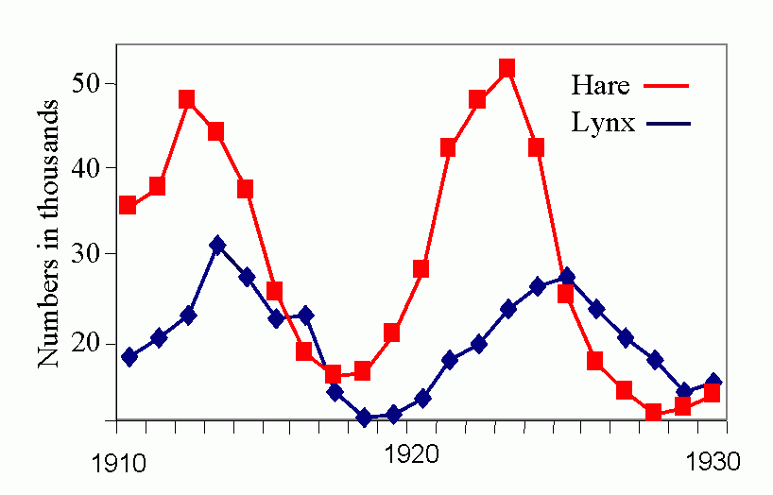
Skill Closure
What is a dynamic equilibrium in an ecosystem?
Skill Closure
Describe what is happening in this population graph.
Interpreting Population Graphs
Describe the general shape of the graph Make an inference about what causes the change in shape of the graph

Slide 22
Independent Practice
Complete the worksheet on Population Graphs on your device or a paper copy.
Marigold
Rafflesia
Trumpet Vine
Cactus
Jasmine
Bottlebrush

